Slide 1
ONLINE JOB PORTAL SYSTEM
GROUP 15
Subin
Rifah Nazar
Salmi Majmal

Slide 2
3 TYPES OF USERS
Administrator – users are controlled by admins
Job Seeker - users searching through databases
Job Provider – users adding to the database

Slide 3
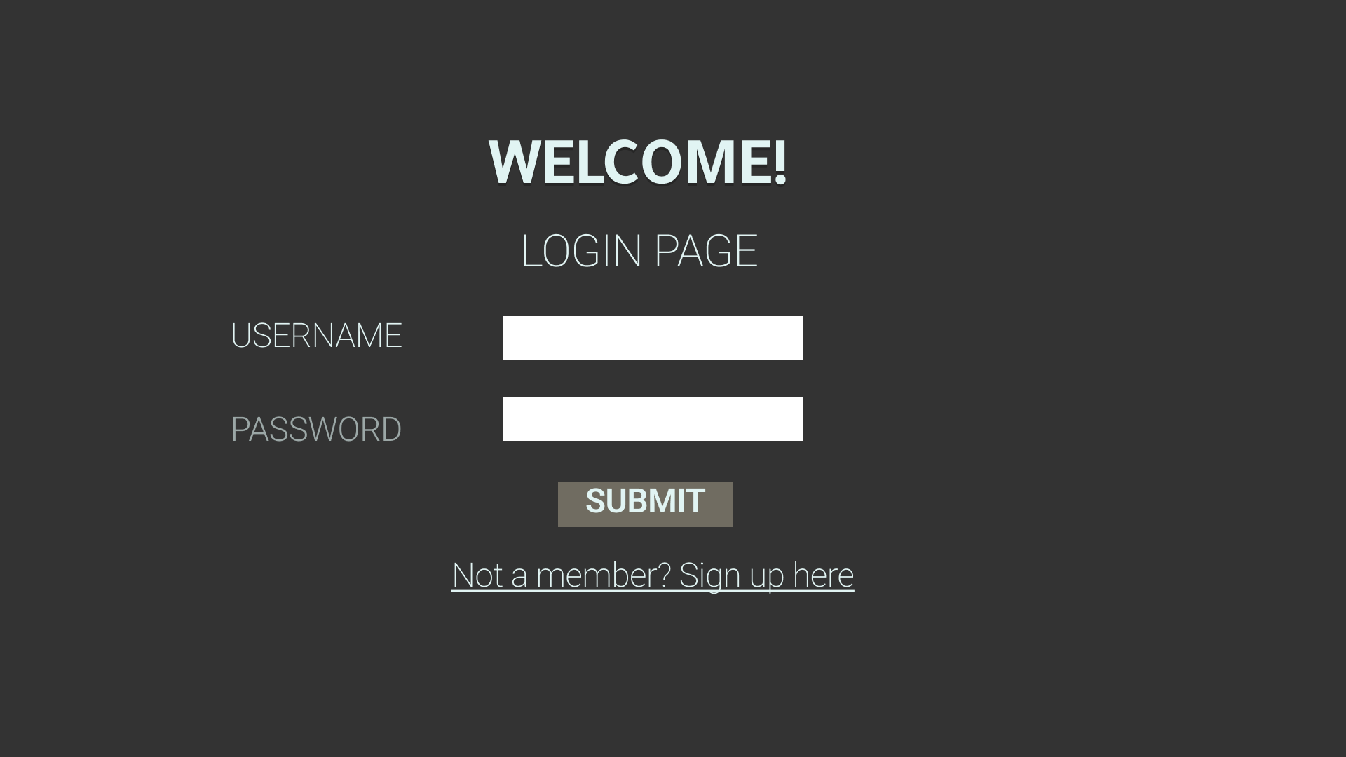
LOGIN PAGE

Slide 4
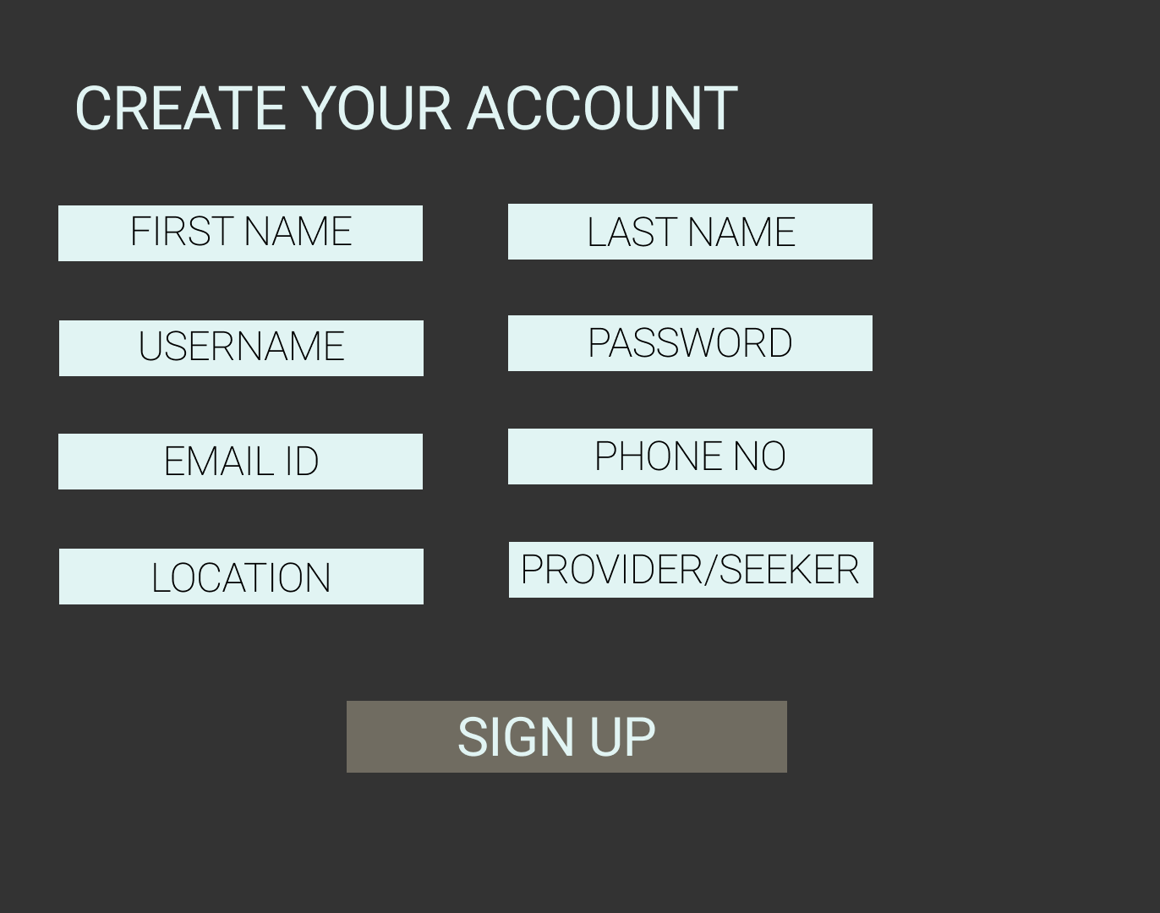
USER REGISTRATION PAGE

Slide 5
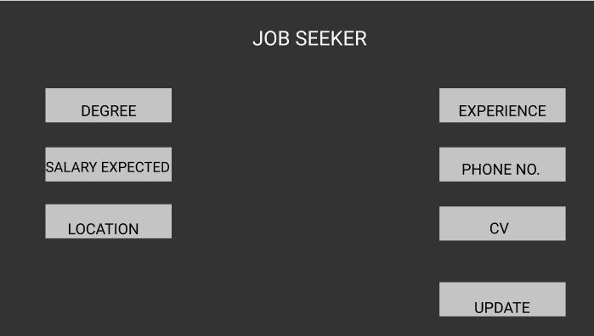
USER PROFILE

Slide 6
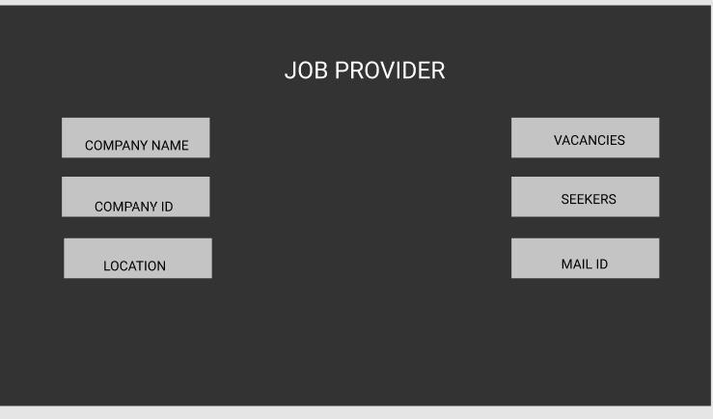
RECRUITER PROFILE
SECTOR
UPDATE

Slide 7
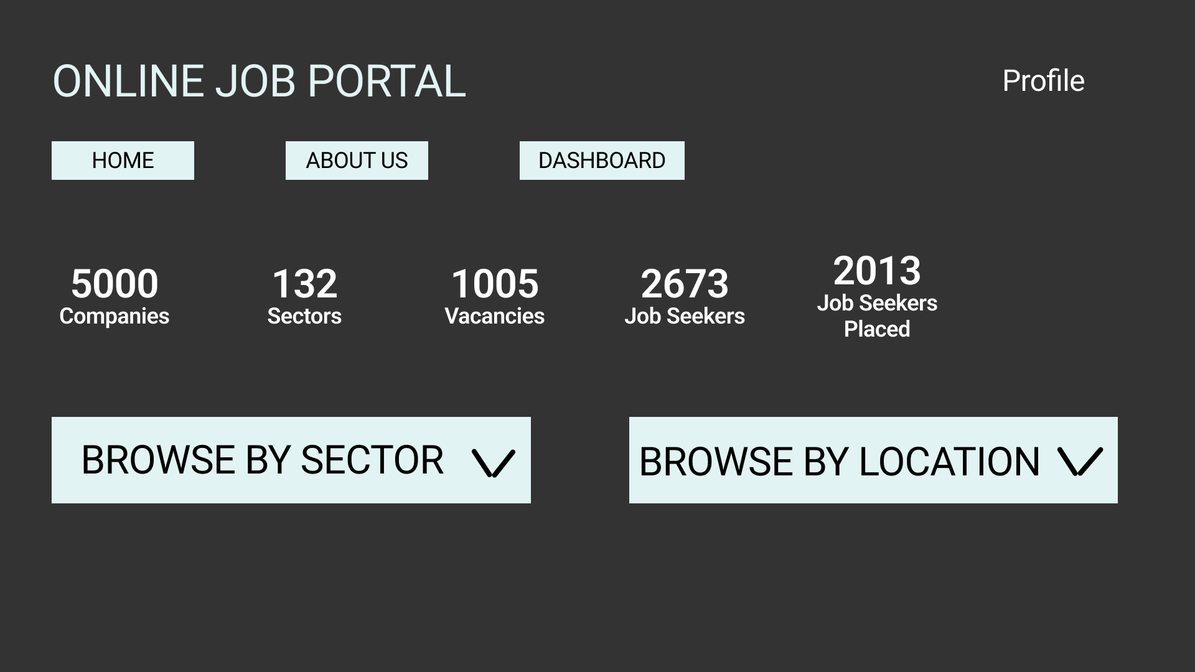
HOME PAGE

Slide 8
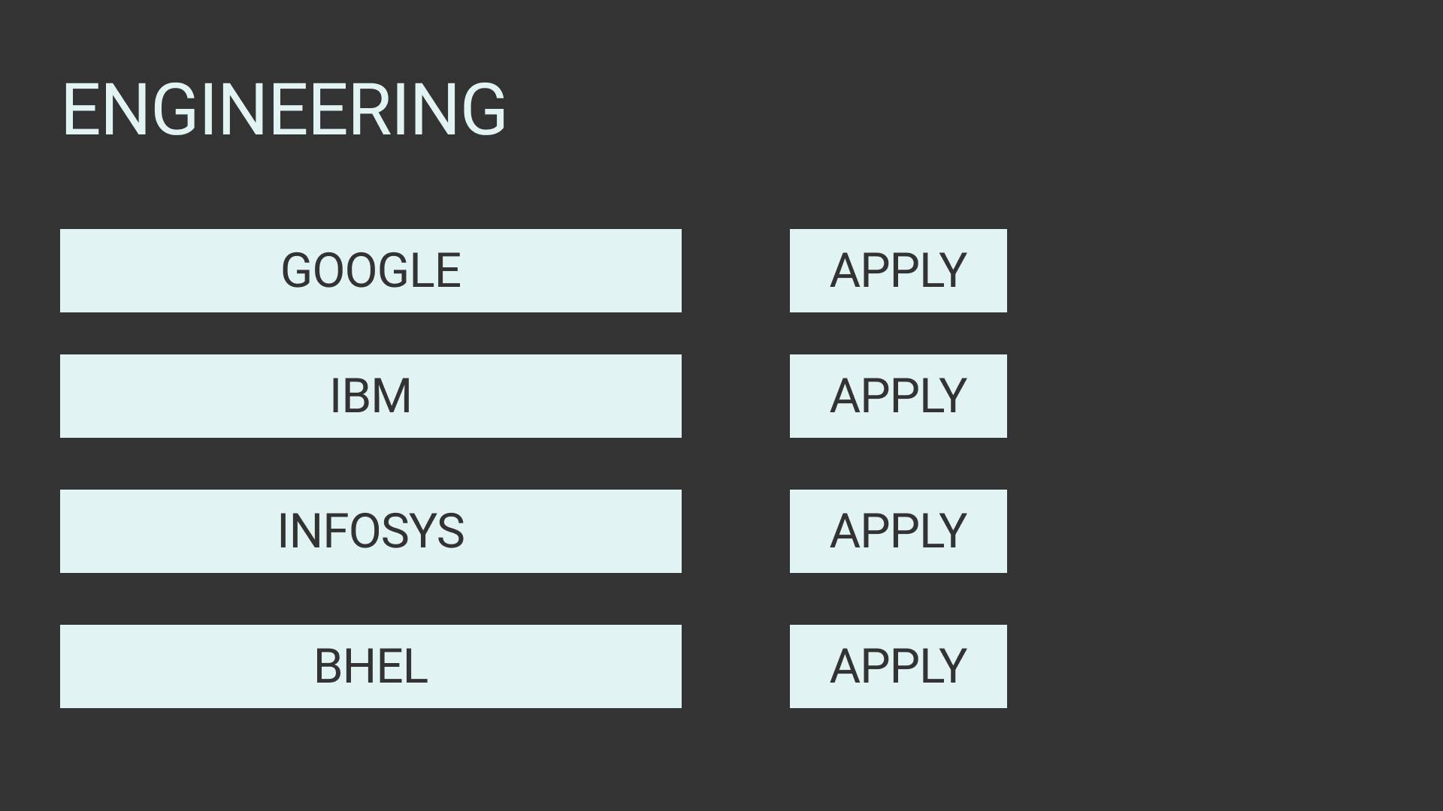
COMPANY LIST

Slide 9
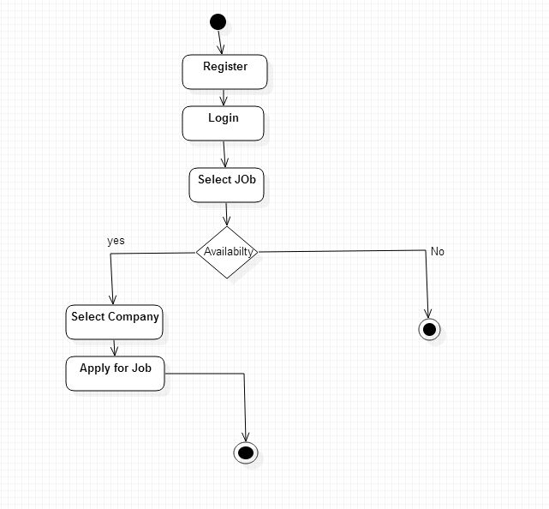
ACTIVITY DIAGRAM

Slide 10
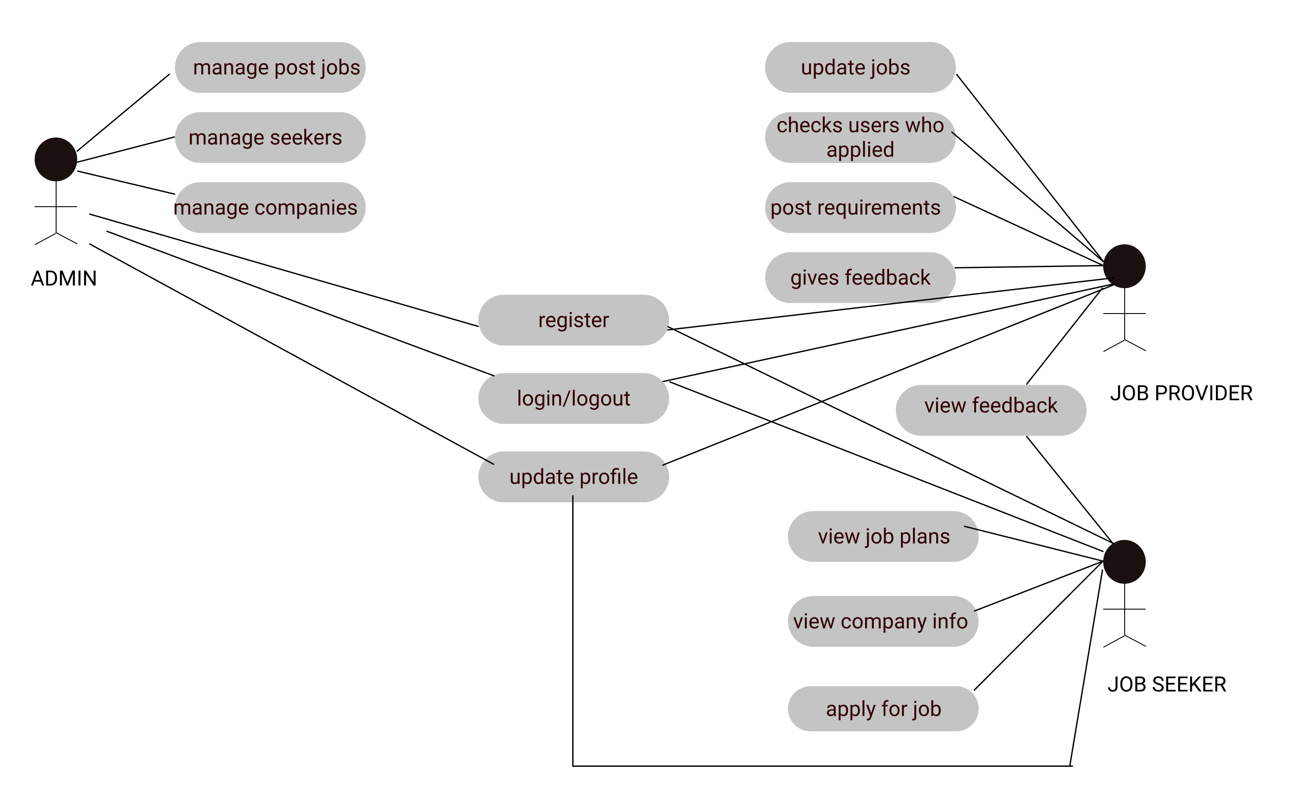
USE-CASE DIAGRAM

Slide 11
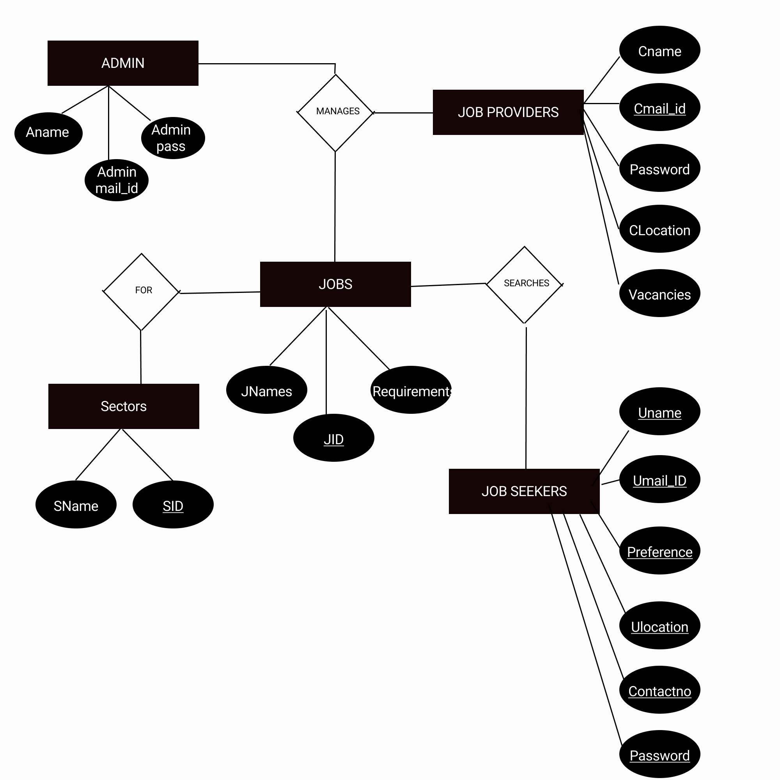
ER DIAGRAM

Slide 12
DATABASES
JOB PROVIDERS
Cname | CID | CLocation | Vacancies | Sectors | Mail_ID | Contactno | Password | username
2. JOB SEEKER
Uname | Mail_ID | Preference | ULocation | Contact_no | Password | username

